Slide 1


Human First Leadership,
AI Powered
Sterling Chin
Senior Developer Advocate
Notes:
Hey everyone! I'm Sterling, Senior Developer Advocate at Postman.

Slide 2
I have a confession to make…
Notes:
Confession. I prepared this talk by talking to my phone for five minutes and then spending a couple hours with Anthropic's Claude Opus shaping it into something useful. Pre-AI, I would have spent days writing and rewriting, in between meetings, and likely a few late nights. Outline after outline, draft after draft. Now, with the help of AI, I can do more in less time. And the time I’ve saved? That's extra 1:1s with my team. It’s extra time focusing on leading my team. And that's exactly what we're here to talk about. Human first leadership, powered by AI.

Slide 3
Robot Sterling
The Problem
Notes:
Look, this isn't going to be a polished TED talk. This is the conversation I wish someone had with me two years ago when I was up to my neck in notes and losing track of my team's work.
I used to wake up drowning in messages. Now I wake up and ask my team how they're doing. So let's just talk shop.

Slide 4
The Problem: Robot Sterling
Postman Labs
21 people
India, Dubai, London, US
Build fast, ship fast
Shipped 7 products from 0-1 in 2.5 years
Postbot, Flows, and support for GraphQL, gRPC, Websockets, and more
Notes:
Two years ago, I was the engineering manager for the R&D arm of Postman called Labs. In Labs, I was managing 21 people across six time zones. We had engineers in Dubai, London, India, and scattered across the US. The goal of Labs was to build fast, ship fast, get customer feedback, and iterate.

Slide 5
The Problem: Robot Sterling
Postman Labs
21 people
India, Dubai, London, US
Build fast, ship fast
Shipped 7 products from 0-1 in 2.5 years
Postbot, Flows, and support for GraphQL, gRPC, Websockets, and more
Notes:
We shipped seven products from 0-1 in two and a half years, and that doesn't include the products and features we started and later either abandoned or put to the back burner. If you're familiar with Postman, you may have used some of the features the Labs team released, like, Postbot, our AI assistant, Postman Flows, and new support for API protocols like GraphQL, gRPC, and Websockets.

Slide 6
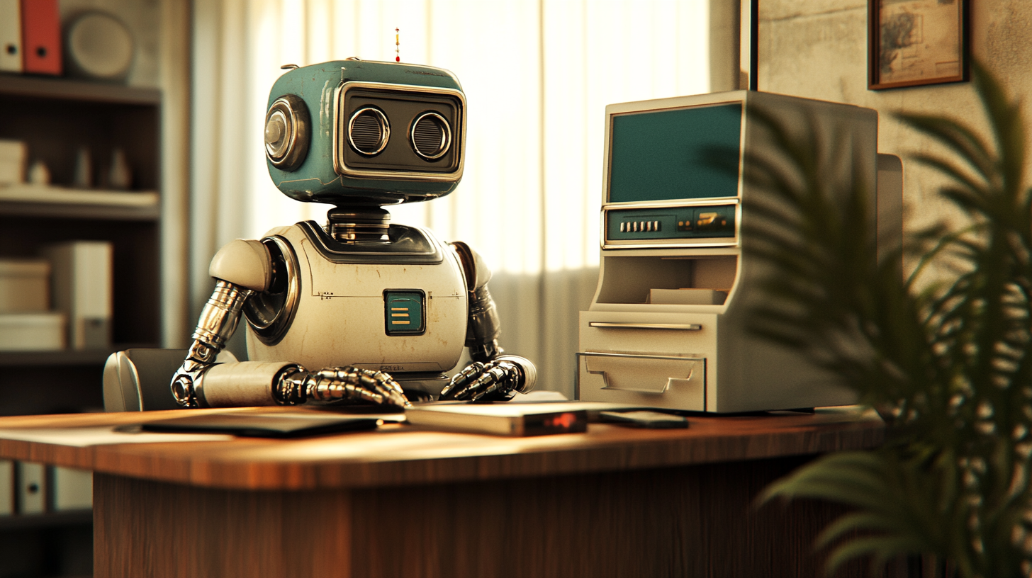
The Problem: Robot Sterling
Notes:
But behind that success was a very human cost.
Picture this: It's 11 PM. I'm in for bed when my phone pings. One of my engineers in Bangalore India, has a question about a task. If I don't answer, they're blocked for their entire day. So I get out of bed, walk to my home office, and dig through my notebook where I track my meeting notes. All the while, trying not to wake up my kids or my wife who are sleeping.

Slide 7
The Problem: Robot Sterling
Notes:
This wasn't a one-time thing. This was my life.
Every morning, I'd wake up to 100+ unread Slack messages spread across various channels and threads. My first hour wasn't spent thinking about strategy or preparing for meaningful conversations. It was archaeology. I was digging through overnight conversations, trying to piece together what decisions were made, what problems arose, who needed what.

Slide 8
The Problem: Robot Sterling
Notes:
And the worst part? My family felt it too. Sunday night was Monday morning in India. So while my kids wanted bedtime stories, I was answering questions from my team in Bangalore. During family movie nights, I was on my phone because someone needed clarification on sprint priorities. At family dinners, I wasn't listening to my kids stories from school - I was managing time zones in my head, or worse, I was on my phone.
I was never fully present anywhere. Not for my team. Not for my family. Not for myself.

Slide 9
The Problem: Robot Sterling
“Time to First Human”
Notes:
Last year, a colleague and I coined a phrase that captures everything: "Time to First Human." They were joking about wanting AI to handle their dating apps so they could just meet actual humans faster. We realized that after all is said and done, what we’re really trying to do is get to a human faster.

Slide 10
The Problem: Robot Sterling
“Time to First Human”
Notes:
So? Here’s what was blocking my time to first human.
Information was scattered across Slack, Confluence, Jira, email, physical notebooks, Google Docs - it was organizational chaos. The mental load of tracking everything was exhausting. That constant anxiety: "What am I forgetting? What ball am I about to drop?"
Then there was the context switching. Going from meeting to meeting with no time to breathe. Sometimes we even had meetings about meetings. Each switch cost me 10-15 minutes just to remember where we left off last time.

Slide 11
AI Experiments
The Solution Journey
Notes:
The stress was constant. I lost sleep. Lots of it. Not just from the midnight notebook runs, but from the weight of trying to be everything to everyone.
Something had to change. My first experiments with AI weren't sophisticated. They were desperate.

Slide 12
The Solution Journey
Start simple
Notes:
I started simple. I'd copy Slack threads and paste them into AI and ask: "What did I miss?" Just getting a TLDR of overnight conversations saved me half an hour or more every morning.

Slide 13
The Solution Journey
Start simple
Zoom Audio --> AI Transcription Service --> AI meeting summary
Notes:
Then I discovered I could do more. Before AI note-takers existed, I would recording Zoom meetings, pull the audio from the recording, and then use an AI transcription API to convert them to text. Then I'd take the transcript and have AI create a meeting summary that I could share with my team. I wasn't waiting for perfect solutions - I was hacking together what I needed.

Slide 14
The Solution Journey
There are no silver bullets when it comes to AI tools.
Notes:
And one thing to note, that in my experience there is no silver bullet! No AI tool was going to magically fix everything.
I had to start with the right mindset. I asked myself one question:

Slide 15
The Solution Journey
“If I had an executive assistant, what would I delegate?”
Notes:
"If I had an executive assistant, what would I delegate?" Everything I'd give to an executive assistant? That's what AI should handle. Taking notes? Summarizing meetings? Tracking action items? Organizing information? All tasks an executive assistant could handle.
I had to shift my mindset. I wasn't looking for a single tool to fix my problems. I was looking at my problems and finding tools that could help.

Slide 16
The Solution Journey
You can't just throw AI at chaos and expect magic
Notes:
You can't just throw AI at chaos and expect magic. You need to understand where you're drowning first.
As I got more comfortable, I started training myself to work better with AI. When I started testing AI note takers during meetings, the way I spoke changed.

Slide 17
The Solution Journey
Use phrases like:
“To summarize…”
“The problem is…”
“An action item is…”
“________ is responsible for…”
Notes:
I started to speak as if we had an executive assistant in the room with us. I started to use phrases like: "To summarize, the problem is..." or "Ok, so one action item is <blank> and Sterling will own it."
Of course, there were failures. I'll never forget sending out meeting notes where AI had carefully transcribed our pre-meeting chat about weekend plans as action items. "John will investigate the new Thai restaurant" was not, in fact, a sprint task. My team got a good laugh. I learned to review before sending.

Slide 18
The Solution Journey
Be honest with yourself and your team
“Yes, I’m using an AI note taker. If you say ‘this is private’, I’ll stop the note taker”
Build trust with your team
Notes:
And I was completely transparent with my team: I let them know I was using an AI note taker. In my 1:1s or if someone on my team mentioned that we needed to talk in private, I would stop the recording, or go back and delete that portion of the conversation. That openness built trust.
As my experiments proved successful, I started building a real system. Let me show you a few of the tools I use.
And a brief caveat, I'm not being paid by any of these companies to endorse their products. I share them with you because I like them.

Slide 19
The Solution Journey
Tools I use
Bloks
Notes:
First, Bloks is my AI meeting notetaker.

Slide 20
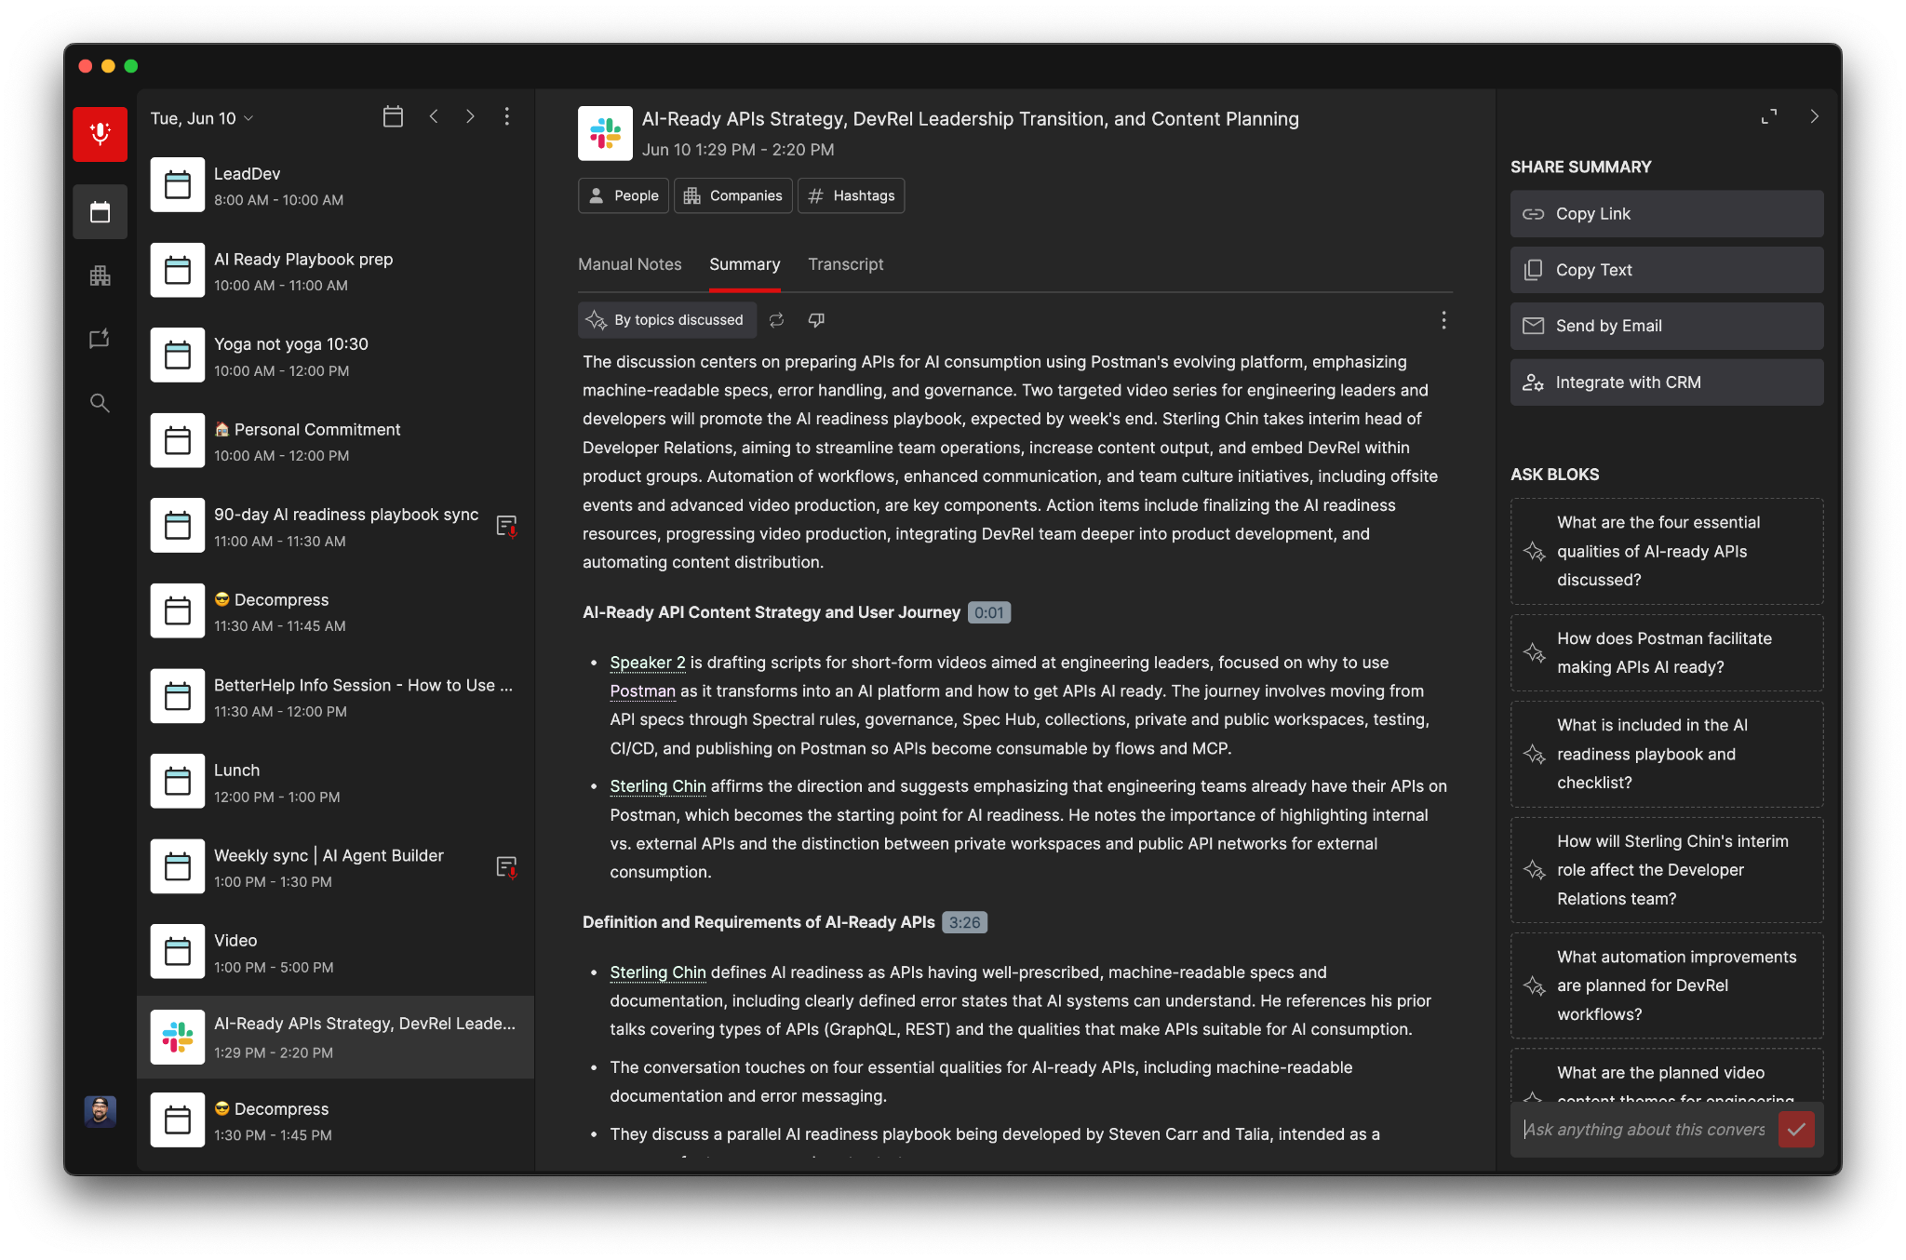
Notes:
It’s my external brain for meetings. Every meeting transcript is in one place, searchable and labeled. It automatically joins my Zoom meetings and Slack huddles.

Slide 21
The Solution Journey
Tools I use
Bloks
MacWhisper
Notes:
Then I discovered the power of voice. On my laptop, I've got a program that completely changed how I work. Anywhere I can edit text, I can use a hot key and simply start talking. It uses AI under the hood to understand context. It gets my technical terms right. It nails the punctuation. I went from spending 10 minutes fixing transcription errors to just... talking.

Slide 22
The Solution Journey
Tools I use
Bloks
MacWhisper
Google Recorder
Notes:
When I'm out and about, I use the voice recorder on my Pixel. I can be anywhere - walking between buildings, grabbing coffee, commuting - and capture ideas instantly. That thought I had while getting coffee? It's waiting for me when I get back to my desk, perfectly transcribed, ready for action.

Slide 23
The Solution Journey
Tools I use
Bloks
MacWhisper
Google Recorder
Claude Projects
Notes:
If you haven’t used projects in Claude or ChatGPT, you’re missing out! I started creating Claude projects for every project and team member. What started as endless Notion docs - two years of conversations, goals, growth areas, blockers - became AI-powered context.

Slide 24
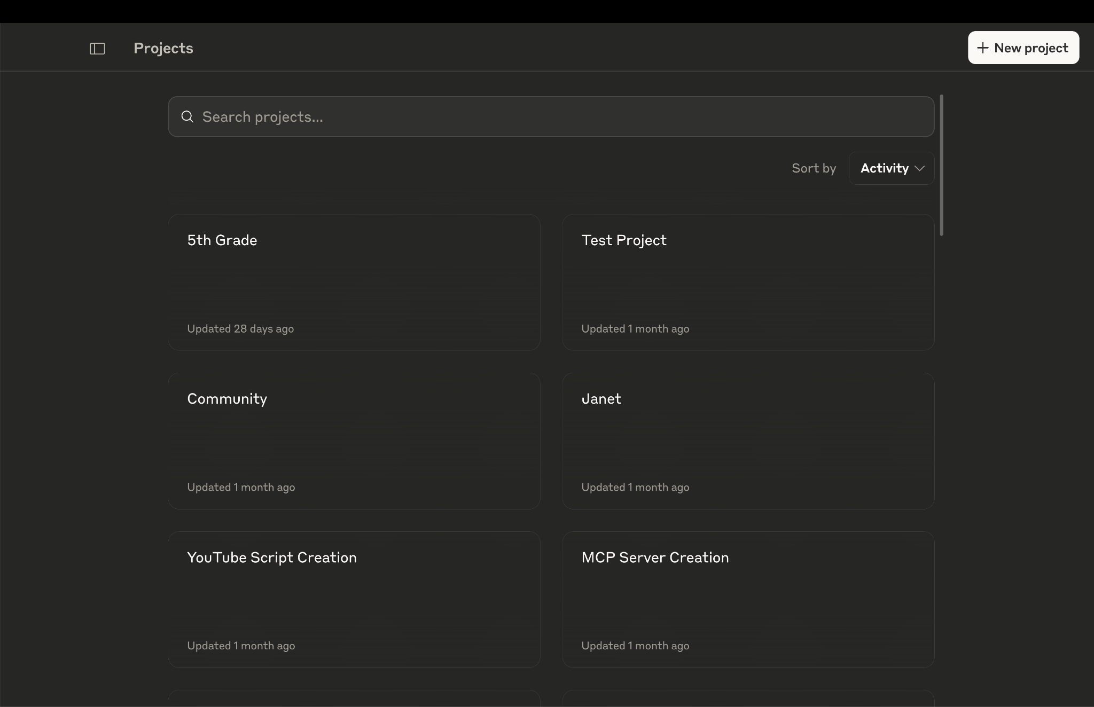
Notes:
Now after each 1:1 or meeting, I take the meeting transcript from Bloks and add it to a dedicated Claude project. Claude becomes my assistant, keeping track of all the artifacts, action items, and ongoing conversations. Before our next 1:1, I don't scramble through notes. I ask Claude: "What are Sarah's current goals? What did we discuss last time?"

Slide 25
The Solution Journey
Tools I use
Bloks
MacWhisper
Google Recorder
Claude Projects
MCP servers
Notes:
And more recently I've discovered MCP servers. MCP stands for Model Context Protocol

Slide 26

The Solution Journey
Model Context Protocol
Notes:
Real quick, let's do an audience poll.
How many of you have heard of MCP?
Of those who've heard of MCP, how many of you have actually created, or used an MCP server yourself?
And for the rest of us, raise your hand if today is the first time you've heard of MCP or Model Context Protocol.
Ok, so let me take a moment to explain what MCP is.
MCP gives your AI the tools and resources it needs to take action on your behalf.

Slide 27
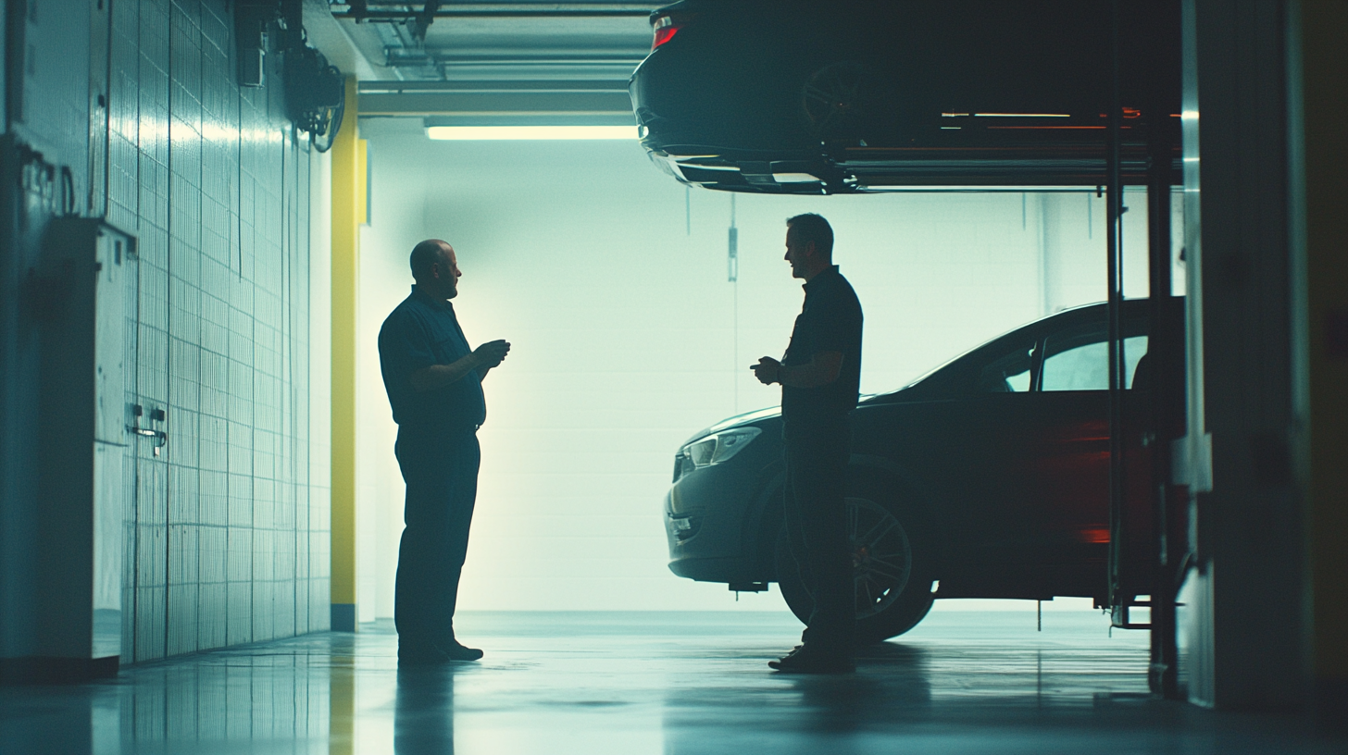
The Solution Journey: MCP
Notes:
Imagine you take your car to a mechanic (the mechanic is the LLM). Before MCP, it's like going to a mechanic who has all the knowledge but no tools. They can tell you exactly how to change your oil, step by step, but you have to do it yourself.

Slide 28

The Solution Journey: MCP
Notes:
With MCP, that mechanic has a garage full of tools that you've provided it. When you need an oil change, the LLM can grab their tools and actually do the work.
Let me show you how MCP is changing how I interact with AI. First, let me tee up this demo.

Slide 29
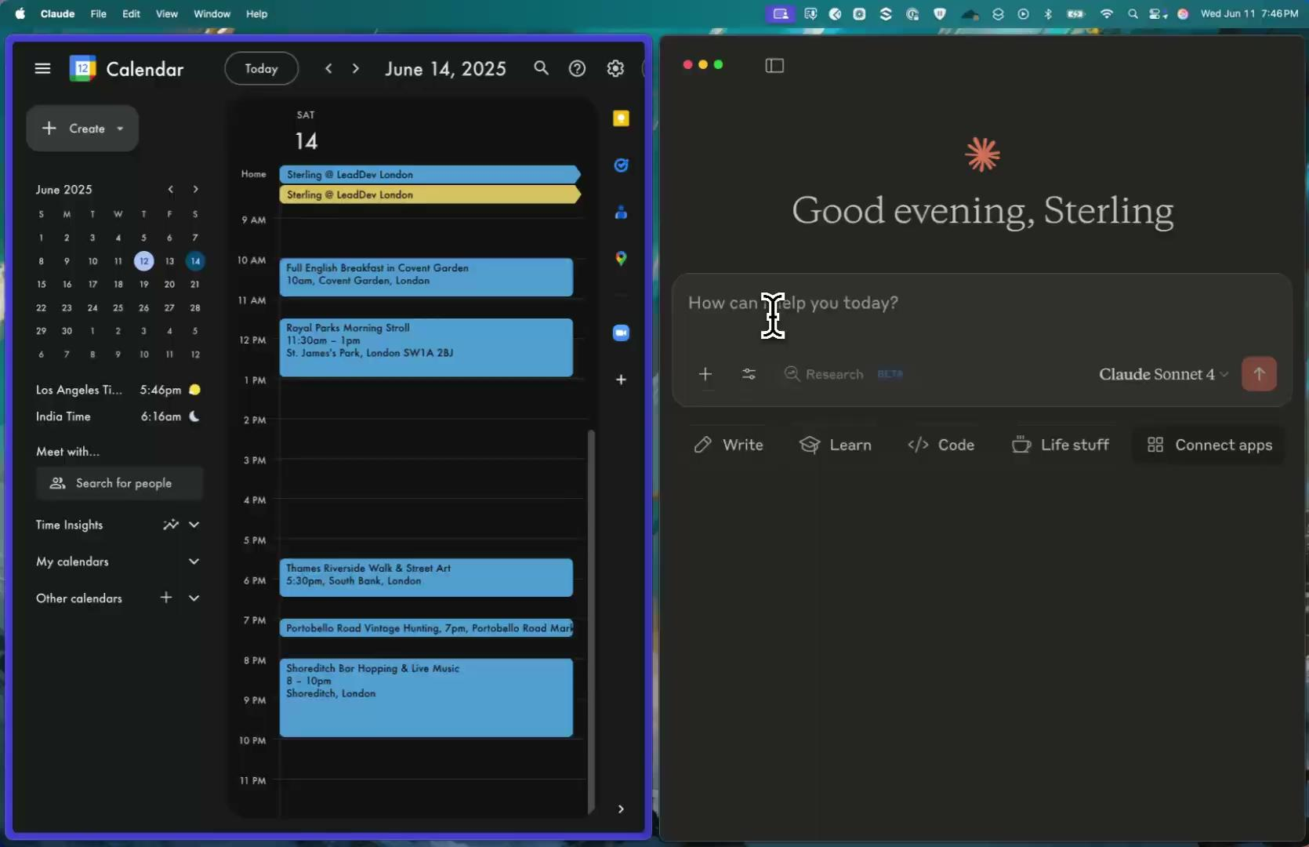
Notes:
On the right, you’ll see Claude open. I’ve connected it to an MCP server that connects to my work calendar. On the left, you’ll see my calendar. All this is in real time, and not sped up at all.
WOW!!!!!

Slide 30
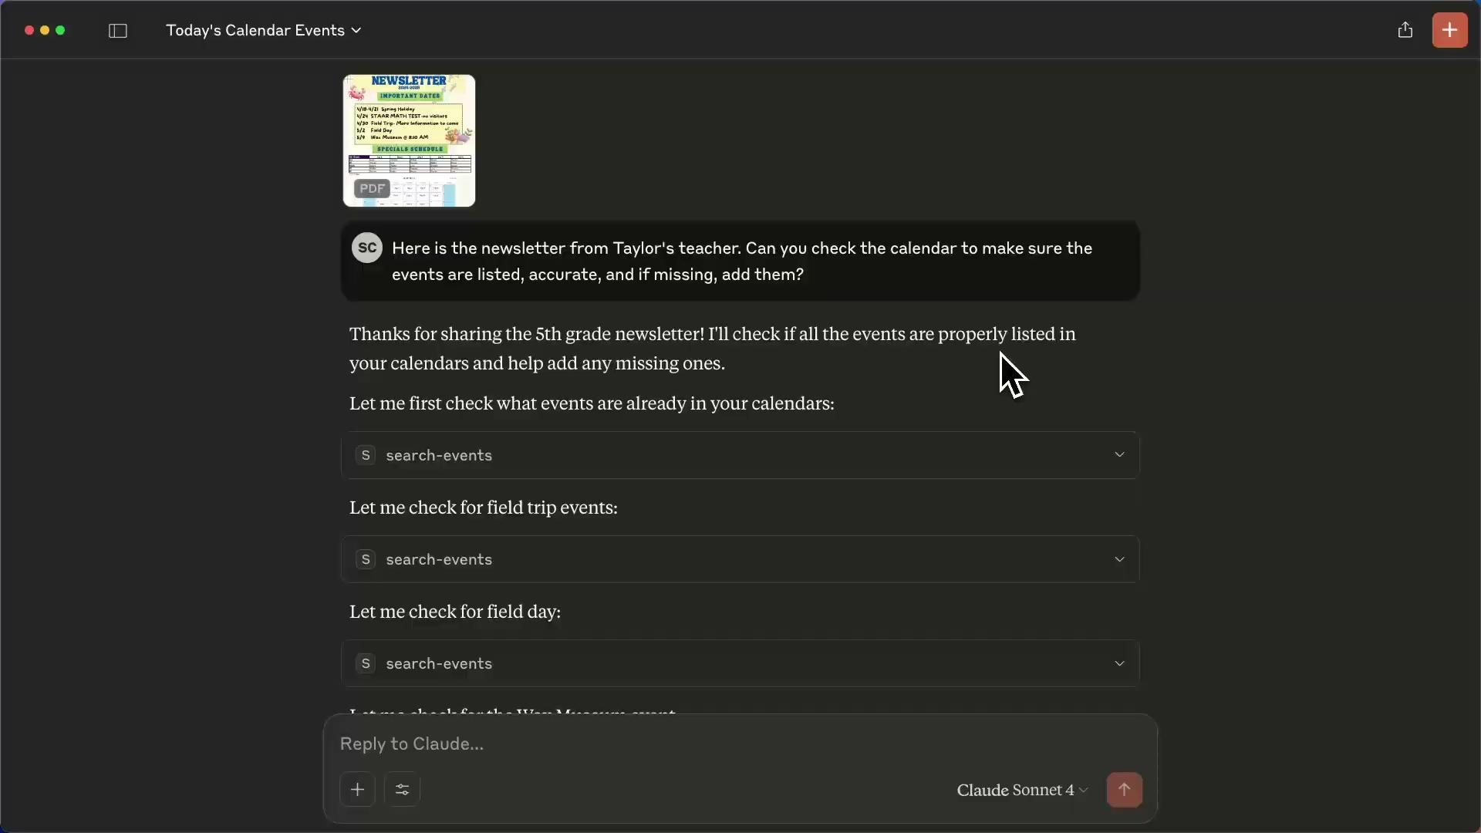
Notes:
If that didn’t impress you, here’s a real life example from a few weeks ago.
My son's school sent an 18 page newsletter. I used to spend 20 minutes manually adding dates to my calendar. Watch this: "Here's the newsletter. Can you add all the important dates to my calendar?" Done. 30 seconds.

Slide 31
The Solution Journey
Model Context Protocol
Notes:
That's MCP - AI with actual tools to work in your systems. It can connect to Confluence for documentation, Slack for communication, calendars for scheduling, email for correspondence. It's not just advice anymore; it's action.
And the tools I use are still evolving. New tools come online constantly. I'm still finding new problems to solve or processes to optimize. It's a journey, not a destination.

Slide 32
Systematic change
The Transformation
Notes:
My mornings are completely different. No more archaeology through 100+ messages. Instead: "Hey team, how's everyone doing?" Real questions. Real presence. Time to first human.
Meetings changed too. I make eye contact now. When someone's sharing a difficult problem, I'm not glancing at my notebook or typing furiously. I'm there. Fully there. And you know what? People notice. They open up more. They share real concerns, not just status updates.

Slide 33
Systematic change
The Transformation
Notes:
But here's what I didn't expect - it wasn't just me who became more present. Once my team realized they could rely on my AI note-taker, they stopped frantically scribbling too. They knew the action items would be captured. They knew the decisions would be documented. They trusted the system.

Slide 34
Systematic change
The Transformation
Notes:
So now, even when we're going through Jira boards and tickets - the necessary business stuff - the whole team is more engaged. Nobody's half-listening while trying to write everything down. We're all actually in the conversation together. It transformed not just my presence, but the entire meeting dynamic.

Slide 35
Systematic change
The Transformation
Notes:
The team dynamic shifted. They no longer ask "What was decided?" because I share AI summaries after every meeting. I'm no longer the hub, information flows more freely. There's less uncertainty, fewer clarifying threads, more actual work.

Slide 36
Systematic change
The Transformation
Notes:
And at home? Sunday night is family time again. Story time is story time. Dinner is dinner. I'm more present with my family.
That engineer in Bangalore? They don't wait anymore. The AI summary is there when they wake up. And I sleep through the night.

Slide 37
Replace robot you
Your Turn
Notes:
Now it’s your turn. Let’s start simple.

Slide 38
Your turn
Start simple
AI note-taker
Voice to text for braindumps
Projects in Claude or ChatGPT
Notes:
First, get one AI note-taker. Try it for a week. Feel what it's like to look someone in the eye during an entire conversation.
Second, try voice-to-text for brain dumps and then let AI help you structure it.
Third, try creating projects in Claude or OpenAI. Maybe for your 1:1s or a specific project. See how it feels to have AI maintaining context for you.

Slide 39
Your turn
Every minute AI saves is one more human moment
Notes:
AI isn't replacing you. It's replacing robot you. Every minute AI saves is one more human moment.

Slide 40
Your turn
Every minute AI saves is one more human moment
Notes:
I used to lose sleep trying to be the perfect manager - the one who remembered everything, tracked everything, never dropped a ball. Now I sleep well knowing AI remembers everything, so I can focus on what matters: being human with my team.
Because when AI handles the context switching and remembering, we get to do what only humans can do: connect, empathize, and lead.

Slide 41
Your turn
Every minute AI saves is one more human moment
Notes:
Your team doesn't need robot you. They need human you. And AI can help you find that person again.
Time to first human shouldn't be a luxury. It should be how we all work.

Slide 42
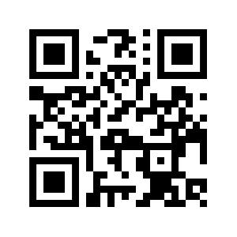





Thank you
www.sterlingchin.com
Notes:
It’s been a pleasure sharing my findings with you.
If you’d like to continue this conversation, you can find me after at the Postman booth.
And if you like to connect with me just scan the QR code, all my links are on my website.
Thank you!

